Slide 1
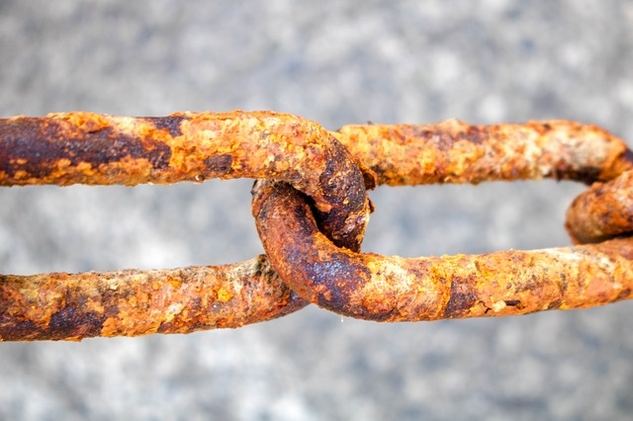
CORROSION

Slide 2
Definition
Corrosion is defined as the spontaneous process of degradation and deterioration of metallic construction in the course of their chemical, biochemical and electrochemical interaction with the environment.
Formation of rust
Fe₂O₃ ·xH₂O
Formation of green film on the Copper surface
[CuCO₃+Cu(OH)₂]

Slide 3
There are 2 types of corrosion
Dry or chemical corrosion.
Galvanic or Electrochemical or Wet corrosion.

Slide 4
Dry or Chemical corrosion
Corrosion on the surface of a metal is due to direct reaction of atmospheric gases like oxygen, halogens, oxides of sulphur, oxides of nitrogen, hydrogen sulphide and fumes of chemicals, with metal. Oxygen is mainly responsible for the corrosion of most metals when compared to other gases and chemicals.

Slide 5
There are three main types of dry corrosion.
1. Oxidation corrosion (Reaction with oxygen)
2. Corrosion by other gases such as H₂, Cl₂ , SO₂ , H₂S, Nox
3. Liquid metal corrosion

Slide 6
Oxidation corrosion (Reaction with oxygen):
Some of the metals directly react with oxygen in the absence of moisture. Alkali and alkaline earth metals react with oxygen at room temperature and form corresponding oxides.
During oxidation of a metal, metal oxide is formed as a thin film on the metallic surface which protects the metal from further corrosion. If diffusion of either oxygen or metal is across this layer, further corrosion is possible. Thus, the layer of metal oxide plays an important role in the process of corrosion.

Slide 7
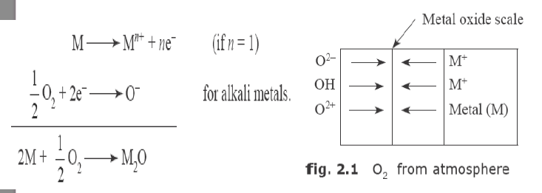

Slide 8
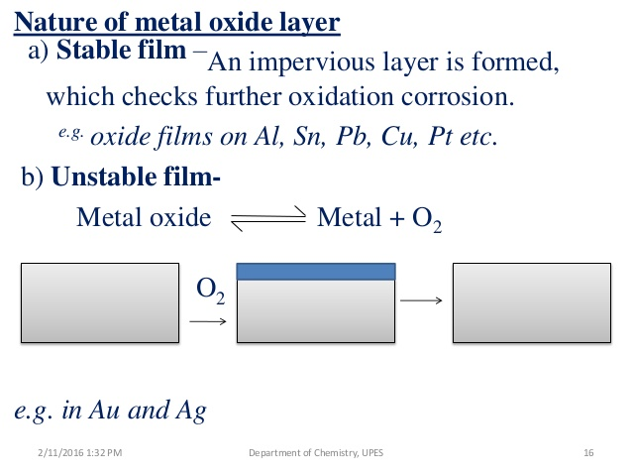

Slide 9
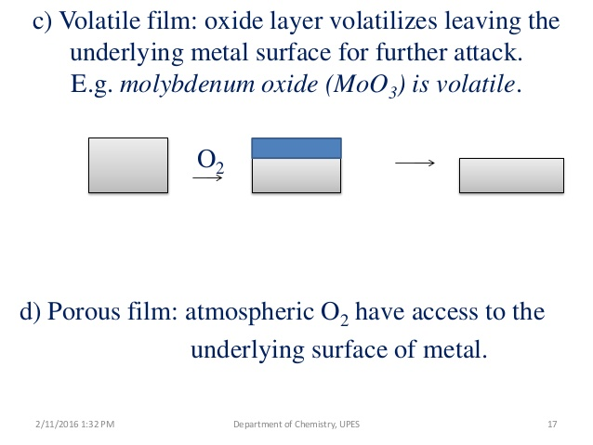
E. g: Oxides of alkali and alkaline earth metals

Slide 10
2:Corrosion by other gases
Besides Oxygen, gases like H₂, Cl₂, SO₂, H₂S, Nox do cause corrosion.The extent of corrosion mainly deprnds on the chemical affinity between the metal and the gas involved.
In dry atmosphere, these gases react with metal and form corrosion products which may be protective or non-protective.
Corrosion by Hydrogen or Hydrogen Embrittlement

Slide 11
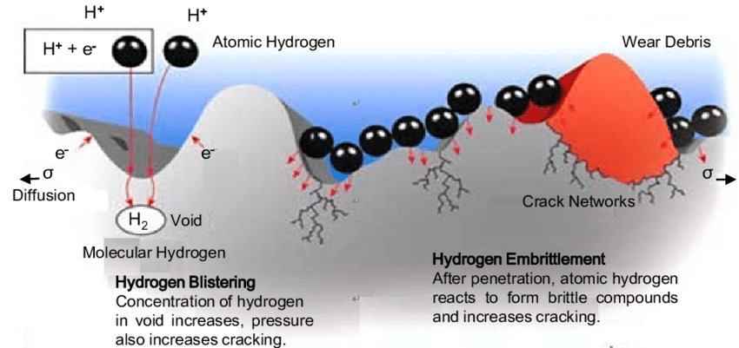
Hydrogen embrittlement

Slide 12
When steel is exposed to theis environment, the atomic hydrogen readily combines with carbon of steel and produce methane gas.
Collection of these gases in the voids develop very high pressure which causes crack.
This process of decrease of carbon content in the steel is called decarburization of steel.

Slide 13
Liquid Metal Corrosion
This type is due to the action of flowing liquid metal at high temperature on solid metal.
This type of corrosion is found to occur in devices used for nuclear power.
The corrosion reaction may involve either the dissolution of the solid metal by the liquid metal or the internal penetration of liquid metal into the solid metal.

Slide 14
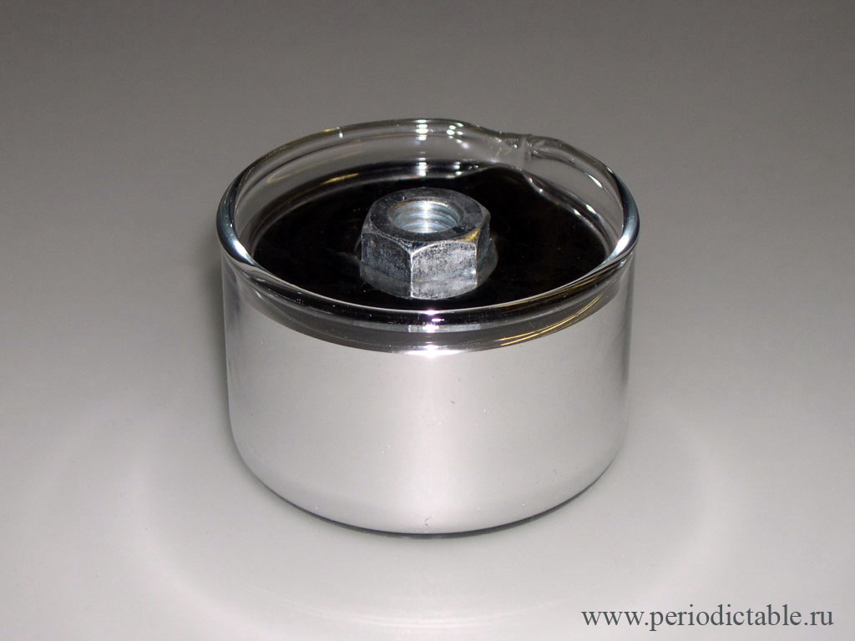
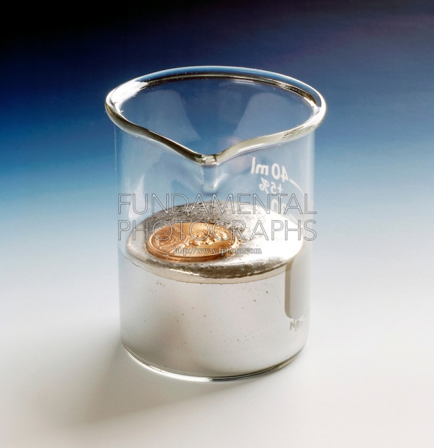
In several industries, molten metal passes through metallic pipes and causes corrosion due to dissolution or due to internal penetration. For example, liquid metal mercury dissolves most metals by forming amalgams, thereby corroding them.

Slide 15
Wet or Electrochemical Corrosion
This type of corrosion occurs when the metal comes in contact with a conducting liquid or when two dissimilar metals are immersed or dipped partly in a solution.
Separate anodic and cathodic regions of set up and current flows through the solution.
Oxidation takes place at anode and reduction occurs at cathode.
Corrosion always occurs at anode and the cathode region remains unaffected.
The metallic ions formed at the anode and the non metallic ions formed at the cathode diffuse through the conducting medium and form the corrosion product.

Slide 16
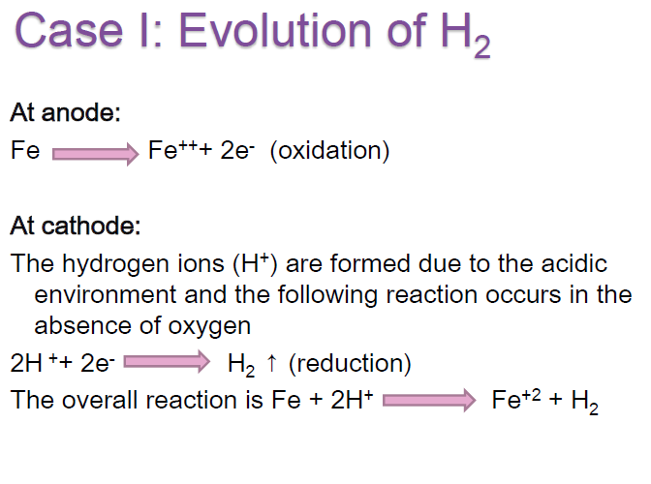

Slide 17
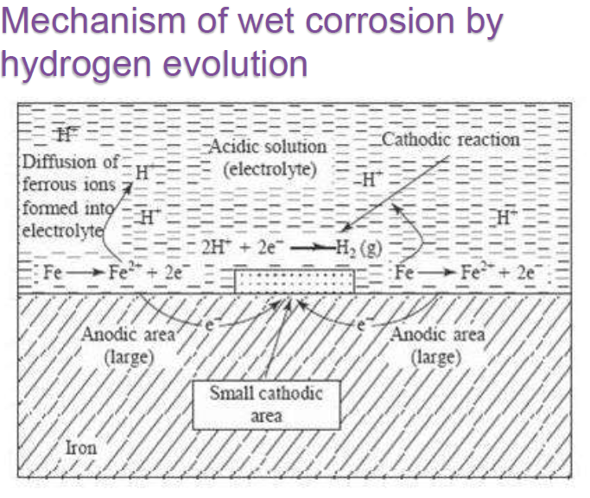

Slide 18
Case II: Absorption of O2
This type of corrosion takes place in neutral or basic medium in the presence of oxygen. The oxide of iron covers the surface of the iron. The small scratch on the surface creates small anodic area and rest of the surface acts as cathodic area

Slide 19
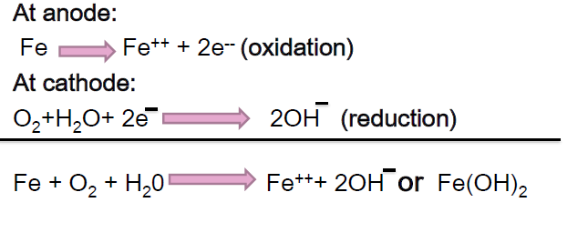

Slide 20
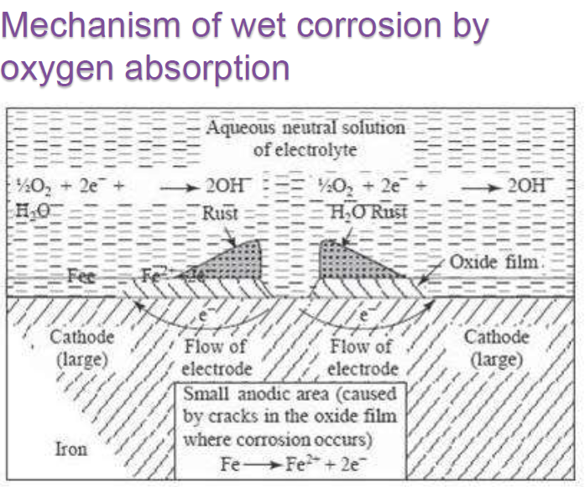

Slide 21
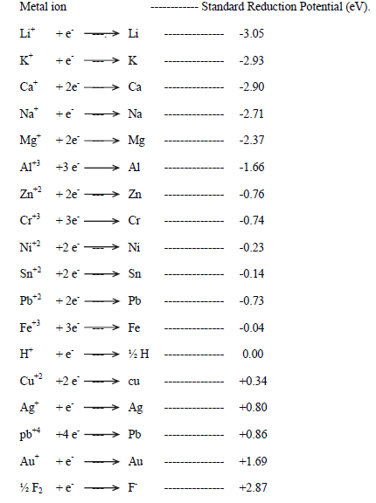
Galvanic series

Slide 22
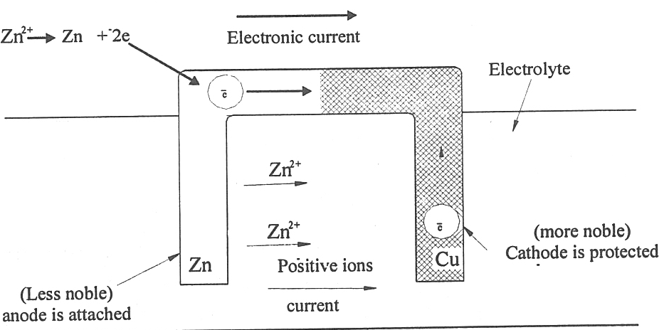
Galvanic corrosion

Slide 23
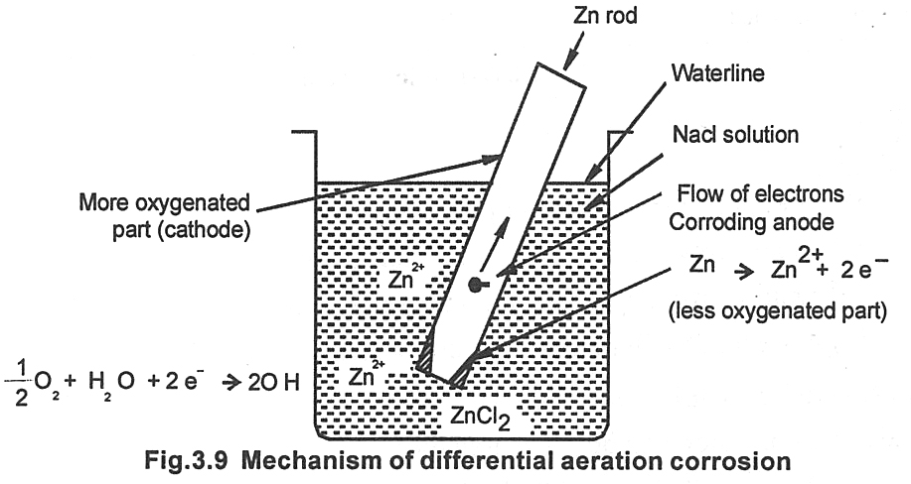
Differential aeration corrrosion

Slide 24
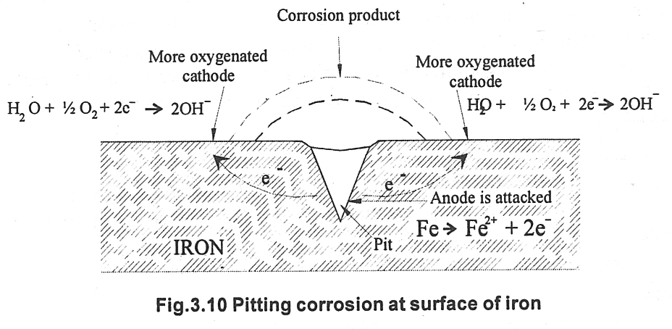
Pitting Corrosion

Slide 25
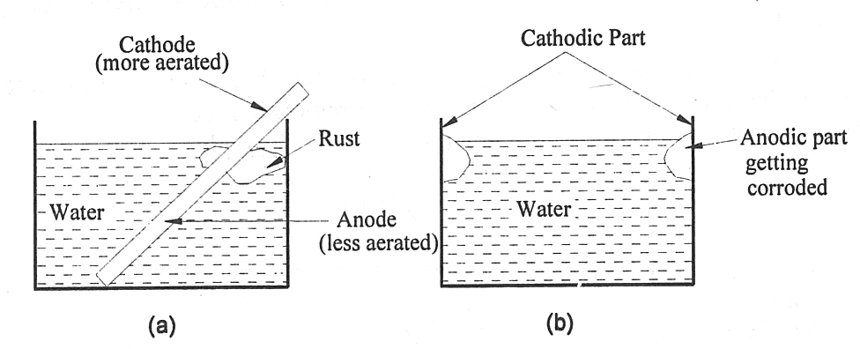
Water line corrosion

Slide 26
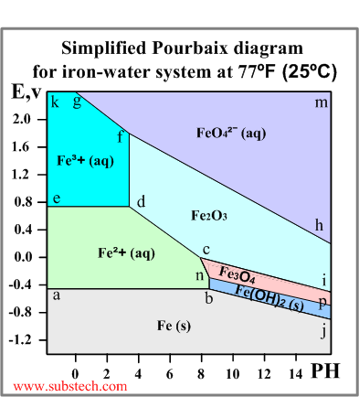
Pourbaix diagrams
Pourbaix diagram (Electrode potential / PH diagram) is a graphical presentation of the thermodynamic equilibrium states of a metal-electrolyte system.
below the line a-b-j: Solid iron (immunity zone). The electrochemical reactions in this zone proceed in the direction of reduction of iron ions. No corrosion occurs in this zone.
a-b-n-c-d-e: Aqueous solution of ion Fe²⁺ (corrosion zone). Metallic iron oxidizes in this zone.
e-d-f-g-k: Aqueous solution of ion Fe³⁺ (corrosion zone). Metallic iron oxidizes (corrodes) in this zone.

Slide 27
h-f-g-m: Aqueous solution of ion FeO₄²⁻ (corrosion zone).
c-d-f-h-i: Solid ferrous oxide Fe₂O₃ (passivation zone). Iron oxidizes (corrodes) in this zone however the resulted oxide film depresses the oxidation process causing passivation (corrosion protection of the metal due to formation of a film of a solid product of the oxidation reaction).
n-c-i-p: Solid oxide Fe₃O₄ (Fe₂O₃*FeO) (passivation zone). The oxide film causes passivation.
b-n-p-j: Solid hydroxide (II) Fe(OH)₂ / FeO*nH2O / green rust (passivation zone).

Slide 28
Application of Pourbaix Diagram for Corrosion Mitigation (or Prevention)
(i) Cathodic Protection
(ii) Anodic Protection
(iii) Environment Modification

